Slide 1
Lecture 9: Deep Neural Network
Instructor: Yang Xu

Slide 2
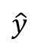
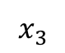
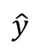
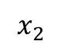
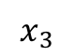
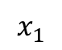
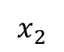
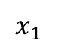
What is a deep neural network?
$$x_{1}$$
$$x_{2}$$
$$\hat{y}$$
2-layer neural network
$$x_{3}$$
$$x_{1}$$
5-layer neural network
$$x_{2}$$
$$\hat{y}$$
$$x_{3}$$

Slide 3
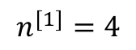
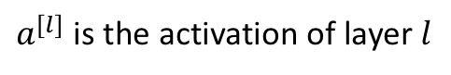
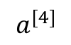
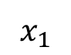
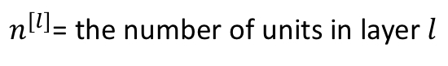
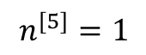
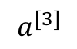
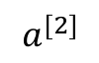
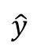
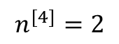
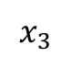
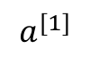
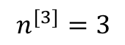
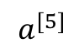
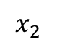
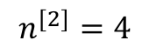
Notations
$$n^{[1]}=4$$
$$n^{[2]}=4$$
$$n^{[3]}=3$$
$$x_{1}$$
$$n^{[4]}=2$$
$$n^{[5]}=1$$
$$x_{2}$$
$$\hat{y}$$
$$a^{[5]}$$
$$x_{3}$$
$$a^{[4]}$$
$$a^{[3]}$$
$$a^{[1]}$$
$$a^{[2]}$$
L = 5
$n^{[l]}$= the number of units in layer $l$
$a^{[l]}$ is the activation of layer $l$
$W^{[l]}$ and $b^{[l]}$ are the parameters associated with layer $l$

Slide 4
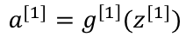
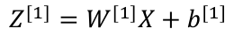
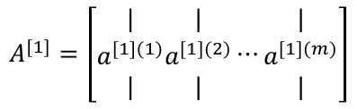
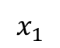
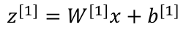
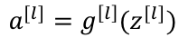
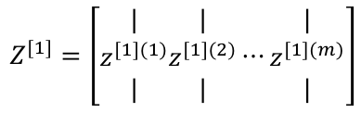
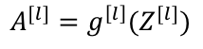
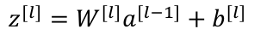
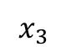
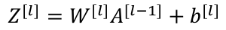
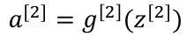
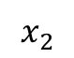
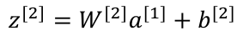
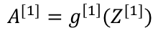
Forward propagation
$$x_{1}$$
$$x_{2}$$
$$\hat{y}$$
$$x_{3}$$
Single example
$$z^{[1]}=W^{[1]}x+b^{[1]}$$
Vectorizing m examples
$$a^{[1]}=g^{\left[1\right]}(z^{[1]})$$
$$Z^{[1]}=\left[\begin{matrix}| \\ z^{[1](1)} \\ |\end{matrix}\begin{matrix}| \\ z^{[1](2)} \\ |\end{matrix}⋯\begin{matrix}| \\ z^{[1](m)} \\ |\end{matrix}\right]$$
$$Z^{[1]}=W^{[1]}X+b^{[1]}$$
$$z^{[2]}=W^{[2]}a^{[1]}+b^{[2]}$$
$$A^{[1]}=g^{\left[1\right]}(Z^{[1]})$$
$$a^{[2]}=g^{\left[2\right]}(z^{[2]})$$
…
$$A^{[1]}=\left[\begin{matrix}| \\ a^{[1](1)} \\ |\end{matrix}\begin{matrix}| \\ a^{[1](2)} \\ |\end{matrix}⋯\begin{matrix}| \\ a^{[1](m)} \\ |\end{matrix}\right]$$
…
$$Z^{[l]}=W^{[l]}A^{[l−1]}+b^{[l]}$$
$$z^{[l]}=W^{[l]}a^{[l−1]}+b^{[l]}$$
$$A^{[l]}=g^{\left[l\right]}(Z^{[l]})$$
$$a^{[l]}=g^{\left[l\right]}(z^{[l]})$$

Slide 5
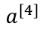
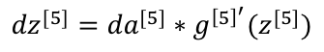
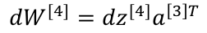
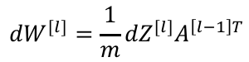
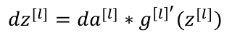
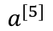
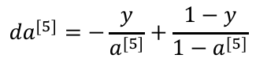
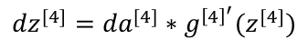
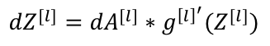
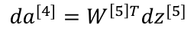
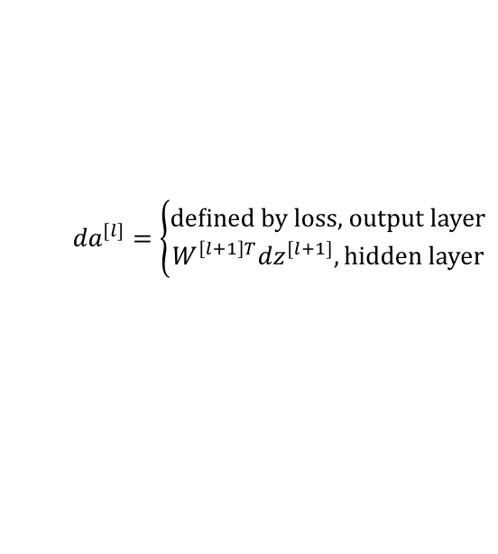









Backward propagation
$${da}^{[4]}=W^{\left[5\right]T}{dz}^{[5]}$$
$$a^{[1]}$$
$$a^{[2]}$$
$${dz}^{[4]}={da}^{[4]}∗g^{{\left[4\right]}^{′}}(z^{[4]})$$
$$a^{[3]}$$
$${da}^{[5]}=−\frac{y}{a^{[5]}}+\frac{1−y}{1−a^{[5]}}$$
$$x_{1}$$
$$a^{[4]}$$
$$a^{[5]}$$
$${dz}^{[5]}={da}^{[5]}∗g^{{\left[5\right]}^{′}}(z^{[5]})$$
$$x_{2}$$
$$\hat{y}$$
For binary classification
$$x_{3}$$
$${dW}^{[5]}={dz}^{[5]}a^{\left[4\right]T}$$
$${db}^{[5]}={dz}^{[5]}$$
$${dW}^{[4]}={dz}^{[4]}a^{\left[3\right]T}$$
$${db}^{[4]}={dz}^{[4]}$$
Single example
Vectorizing m examples
$${da}^{[l]}=\left\{\begin{aligned}\text{defined} \text{by} \text{loss}\text{, }\text{output} \text{layer} \\ W^{\left[l+1\right]T}{dz}^{[l+1]}, \text{hidden} \text{layer}\end{aligned}\right.$$
$${dA}^{[l]}=\left\{\begin{aligned}\text{defined} \text{by} \text{loss}\text{, }\text{output} \text{layer} \\ W^{\left[l+1\right]T}{dZ}^{[l+1]}, \text{hidden} \text{layer}\end{aligned}\right.$$
$${dz}^{[l]}={da}^{[l]}∗g^{{\left[l\right]}^{′}}(z^{[l]})$$
$${dZ}^{[l]}={dA}^{[l]}∗g^{{\left[l\right]}^{′}}(Z^{[l]})$$
$${dW}^{[l]}={dz}^{[l]}a^{\left[l−1\right]T}$$
Reuse the values computed in forward pass
$${dW}^{[l]}=\frac{1}{m}{dZ}^{[l]}A^{\left[l−1\right]T}$$
$${db}^{[l]}={dz}^{[l]}$$
$${db}^{[l]}=\frac{1}{m}\text{np}\text{.}\text{sum}\text{(}{dZ}^{[l]}\text{, }\text{axis}\text{=1, }\text{keepdims}\text{=}\text{True}\text{)}$$

Slide 6















Per layer function
$$a^{[1]}$$
$$a^{[2]}$$
$$a^{[l]}$$
$$x_{1}$$
$$a^{[4]}$$
$$a^{[5]}$$
$$x_{2}$$
$$\hat{y}$$
$$x_{3}$$
Forward
Input $a^{[l−1]}$
Output $a^{[l]}$
Cache $z^{[l]}=W^{[l]}a^{[l−1]}+b^{[l]}$ and $a^{[l−1]}$ for later use in backprop
Backward
Input ${da}^{[l]}$
Output ${da}^{[l−1]}$
Used the cached $z^{[l]}$ to compute: ${da}^{[l−1]}=W^{\left[l\right]T}{da}^{[l]}∗g^{{\left[l\right]}^{′}}(z^{[l]})$
Compute $W^{[l]}$, $b^{[l]}$ as well
$${dz}^{[l]}$$

Slide 7









Visualizing with computation graphs
Layer $l$
$$a^{[l−1]}$$
$W^{[l]}$, $b^{[l]}$
$$a^{[l]}$$
Cache $a^{[l−1]}$, $z^{[l]}$
$${da}^{[l−1]}$$
$W^{[l]}$, $b^{[l]}$
$${da}^{[l]}$$
$${dz}^{[l]}$$
${dW}^{[l]}$, ${db}^{[l]}$

Slide 8
































Stack the building blocks
Layer 1
Layer 2
Layer 3
Layer L
$$x=a^{[0]}$$
$W^{[1]}$, $b^{[1]}$
$$a^{[1]}$$
$W^{[2]}$, $b^{[2]}$
$$a^{[2]}$$
$W^{[3]}$, $b^{[3]}$
$$a^{[3]}$$
…
$W^{[L]}$, $b^{[L]}$
$$a^{[L]}$$
$$\hat{y}$$
Cache $z^{[1]}$, $a^{[0]}$
Cache $z^{[2]}$, $a^{[1]}$
Cache $z^{[3]}$, $a^{[2]}$
Cache $z^{[L]}$, $a^{[L−1]}$
$W^{[1]}$, $b^{[1]}$
$${da}^{[2]}$$
$W^{[2]}$, $b^{[2]}$
$${da}^{[2]}$$
$W^{[3]}$, $b^{[3]}$
$${da}^{[L−1]}$$
$W^{[L]}$, $b^{[L]}$
…
$${da}^{[L]}$$
$${dz}^{[1]}$$
$${dz}^{[2]}$$
$${dz}^{[3]}$$
$${dz}^{[l]}$$
${dW}^{[1]}$, ${db}^{[1]}$
${dW}^{[2]}$, ${db}^{[2]}$
${dW}^{[3]}$, ${db}^{[3]}$
${dW}^{[L]}$, ${db}^{[L]}$
$$W^{[l]}=W^{[l]}−α{dW}^{[l]}$$
$$b^{[l]}=b^{[l]}−α{db}^{[l]}$$

Slide 9
Implementation
Forward
def linear_forward(A, W, b):
Z = …
cache = (A, W, b)
return Z, cache
def forward(A_prev, W, b):
Z, l_cache = linear_forward(…)
A, a_cache = ReLU(…)
cache = (l_cache, a_cache)
return l_cache, a_cache
Sigmoid, tanh, or ReLU

Slide 10

Implementation (cont.)
Backward
def linear_backward(dZ, cache):
A_prev, W, b = cache
dW = …
db = …
dA_prev = …
return dA_prev, dW, db
def backward(dA, cache):
l_cache, a_cache = cache
dZ = ReLU_backward(dA, a_cache)
dA_prev, dW, db = linear_backward(dZ, l_cache)
return dA_prev, dW, db
$$∗g′()$$

Slide 11


Why using deep network?
What is deep network computing?
$$\hat{y}$$
Edges
Parts
Face
Notes:
First layer → simple edge detector: vertical, horizontal
The function of the first layer is to scan the image and then to figure out where the edges are.
Second layer → group edges together to form parts of the face, e.g., eye, nose, lips etc.
Finally → by putting together different parts of a face, it can learn to recognize different faces.
Earlier layers learn simpler features, such as edges.
Later layers can learn more complex features by composing simple ones together.

Slide 12


Parameters and hyperparameters
Building an effective DNN requires not only requires setting up parameters but also hyperparameters
Parameters: $W^{[1]}, b^{[1]}, W^{[2]}, b^{[2]}, …$
Hyperparameters:
learning rate $α$, how to change it
# of iterations, minibatch size
# of layers
# of units in each layer
Activation functions: ReLU, tanh, sigmoid …
Word frequency
Notes:
We call these hyperparameters, because they control how the size of parameters, and how they are learned.

Slide 13
Parameters and hyperparameters
Optimization and Hyperparameter tuning

